Slide 1









WHY NOT BOOK A CLASS?
You have no booked classes
Search for Classes >
COVENTRY SKYDOME
TODAY
REFRESHED AT 11:35
91
PEOPLE CURRENTLY IN THE GYM
0
OF THOSE ARE IN CLASSES
WEIGHT UP
Notify Me Bar
Equipment being used >
VISITS
AVG DURATION
ACTIVITY
CLASSES
12
2h
16m
0
HOME
CLASSES
ACTIVITY
WEIGHT UP
WORKOUTS
ACCOUNT

Slide 2



COVENTRY SKYDOME
Equipment's In Use
FREE WEIGHTS
FULL BODY MACHINES
UPPER BODY MACHINES
HOME
CLASSES
ACTIVITY
WEIGHT UP
WORKOUTS
ACCOUNT

Slide 3
FULL BODY MACHINES
FULL BODY MACHINES
Ping
Treadmill
20 in-use 4 available 1 out of
service
Ping
Rowing
4 in-use 0 available 0 out of
service
Ping
Cycle
16 in-use 5 available 3 out of
service
Ping
HOME
CLASSES
ACTIVITY
WEIGHT UP
WORKOUTS
ACCOUNT

Slide 4
FULL BODY MACHINES
UPPER BODY MACHINES
Bench Press
4 in-use 1 available 0 out of
service
Ping
Lat Pulldown
2 in-use 1 available 1 out of
service
Ping
Peck Deck
0 in-use 2 available 0 out of
service
Ping
HOME
CLASSES
ACTIVITY
WEIGHT UP
WORKOUTS
ACCOUNT

Slide 5
FULL BODY MACHINES
FREE WEIGHTS
8kg Dumbbell
2 in-use 1 available 0 out of
service
Ping
4kg Dumbbell
2 in-use 1 available 1 out of
service
Ping
Curl Bar
0 in-use 2 available 0 out of
service
Ping
HOME
CLASSES
ACTIVITY
WEIGHT UP
WORKOUTS
ACCOUNT

Slide 6
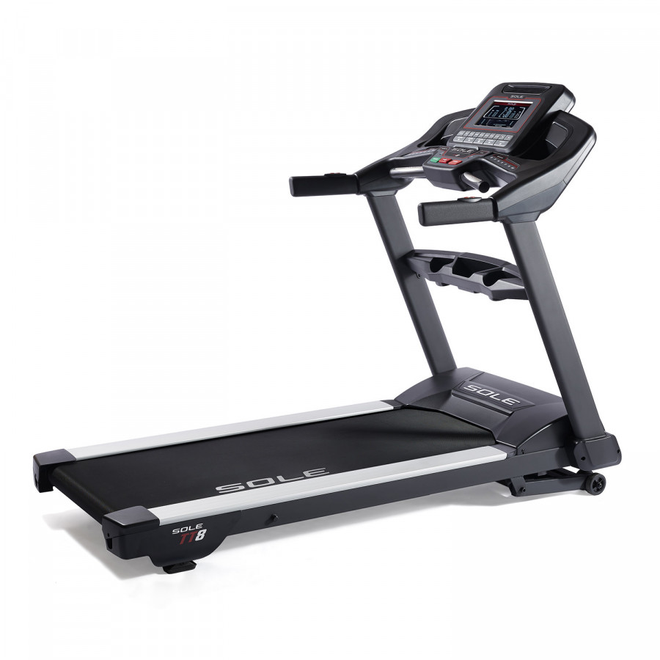
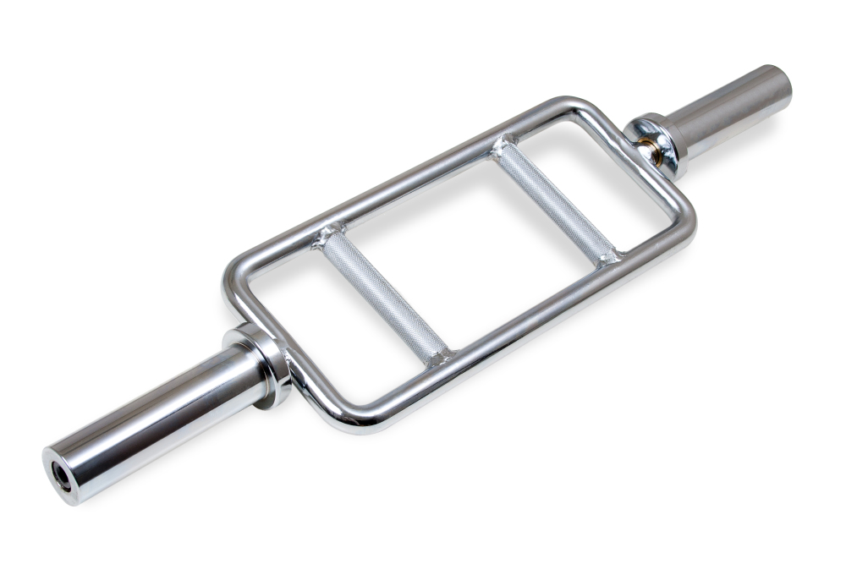
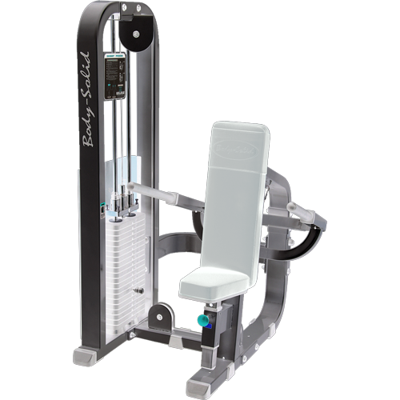
COVENTRY SKYDOME
Equipment's To Queue
Search for an equipment to queue
Treadmill
5
PEOPLE CURRENTLY IN QUEUE
Queue me
Triceps Bar
0
PEOPLE CURRENTLY IN QUEUE
Queue me
Triceps Press
2
PEOPLE CURRENTLY IN QUEUE
Queue me
HOME
CLASSES
ACTIVITY
WEIGHT UP
WORKOUTS
ACCOUNT

Slide 7
COVENTRY SKYDOME
Equipment's To Queue
Search for an equipment to queue
Treadmill
6
PEOPLE CURRENTLY IN QUEUE
Queue me
Triceps Bar
You are 6th in the Queue
0
PEOPLE CURRENTLY IN QUEUE
Queue me
Triceps Press
2
PEOPLE CURRENTLY IN QUEUE
Queue me
HOME
CLASSES
ACTIVITY
WEIGHT UP
WORKOUTS
ACCOUNT

Slide 8
COVENTRY SKYDOME
Equipment's To Queue
Search for an equipment to queue
Treadmill
6
PEOPLE CURRENTLY IN QUEUE
Queue me
Triceps Bar
0
PEOPLE CURRENTLY IN QUEUE
Queue me
Triceps Press
2
PEOPLE CURRENTLY IN QUEUE
Queue me
HOME
CLASSES
ACTIVITY
WEIGHT UP
WORKOUTS
ACCOUNT

Slide 9

WHY NOT BOOK A CLASS?
You have no booked classes
Search for Classes >
COVENTRY SKYDOME
TODAY
0
91
PEOPLE CURRENTLY IN THE GYM
OF THOSE ARE IN CLASSES
WEIGHT UP
You have a Notification
VISITS
AVG DURATION
ACTIVITY
12
2h
16m
0
HOME
CLASSES
ACTIVITY
WEIGHT UP
WORKOUTS
ACCOUNT

Slide 10
COVENTRY SKYDOME
Equipment's In Use
FULL BODY MACHINES
You need to start using Treadmill No-15 within 2:00 min.
FREE WEIGHTS
UPPER BODY MACHINES
HOME
CLASSES
ACTIVITY
WEIGHT UP
WORKOUTS
ACCOUNT

Slide 11
WHY NOT BOOK A CLASS?
You have no booked classes
Search for Classes >
COVENTRY SKYDOME
TODAY
0
91
PEOPLE CURRENTLY IN THE GYM
OF THOSE ARE IN CLASSES
WEIGHT UP
You have a Notification
VISITS
AVG DURATION
ACTIVITY
12
2h
16m
0
HOME
CLASSES
ACTIVITY
WEIGHT UP
WORKOUTS
ACCOUNT

Slide 12
COVENTRY SKYDOME
Equipment's In Use
FULL BODY MACHINES
Sorry, Your spot has been taken,
Please queue again.
:-queue
FREE WEIGHTS
UPPER BODY MACHINES
HOME
CLASSES
ACTIVITY
WEIGHT UP
WORKOUTS
ACCOUNT

Slide 13
COVENTRY SKYDOME
Equipment's To Queue
Search for equipment to queue
Treadmill
6
PEOPLE CURRENTLY IN QUEUE
Queue me
Triceps Bar
Already in the Queue
0
PEOPLE CURRENTLY IN QUEUE
Queue me
Triceps Press
2
PEOPLE CURRENTLY IN QUEUE
Queue me
HOME
CLASSES
ACTIVITY
WEIGHT UP
WORKOUTS
ACCOUNT

Slide 14
COVENTRY SKYDOME
Equipment's To Queue
Search for an equipment to queue
Treadmill
6
PEOPLE CURRENTLY IN QUEUE
Queue me
Triceps Bar
0
PEOPLE CURRENTLY IN QUEUE
Queue me
Triceps Press
2
PEOPLE CURRENTLY IN QUEUE
Queue me
HOME
CLASSES
ACTIVITY
WEIGHT UP
WORKOUTS
ACCOUNT

Slide 15
Sorry, this page is under Construction.
Click on home icon to go back.
HOME
CLASSES
ACTIVITY
WEIGHT UP
WORKOUTS
ACCOUNT

Slide 16
Sorry, this page is under Construction.
Click on the button below to go back
Back
HOME
CLASSES
ACTIVITY
WEIGHT UP
WORKOUTS
ACCOUNT

Slide 17
Sorry, this page is under Construction.
Click on the button below to go back
Back
HOME
CLASSES
ACTIVITY
WEIGHT UP
WORKOUTS
ACCOUNT

Slide 18
Sorry, this page is under Construction.
Click on the button below to go back
Back
HOME
CLASSES
ACTIVITY
WEIGHT UP
WORKOUTS
ACCOUNT

Slide 19
Sorry, this page is under Construction.
Click on the button below to go back
Back
HOME
CLASSES
ACTIVITY
WEIGHT UP
WORKOUTS
ACCOUNT

Slide 20
Sorry, this page is under Construction.
Click on the button below to go back
Back
HOME
CLASSES
ACTIVITY
WEIGHT UP
WORKOUTS
ACCOUNT

Slide 21
WHY NOT BOOK A CLASS?
You have no booked classes
Search for Classes >
COVENTRY SKYDOME
TODAY
0
91
PEOPLE CURRENTLY IN THE GYM
OF THOSE ARE IN CLASSES
WEIGHT UP
1 left
Almost there
Equipment being used >
VISITS
AVG DURATION
ACTIVITY
CLASSES
12
2h
16m
0
HOME
CLASSES
ACTIVITY
WEIGHT UP
WORKOUTS
ACCOUNT

